Slide 1
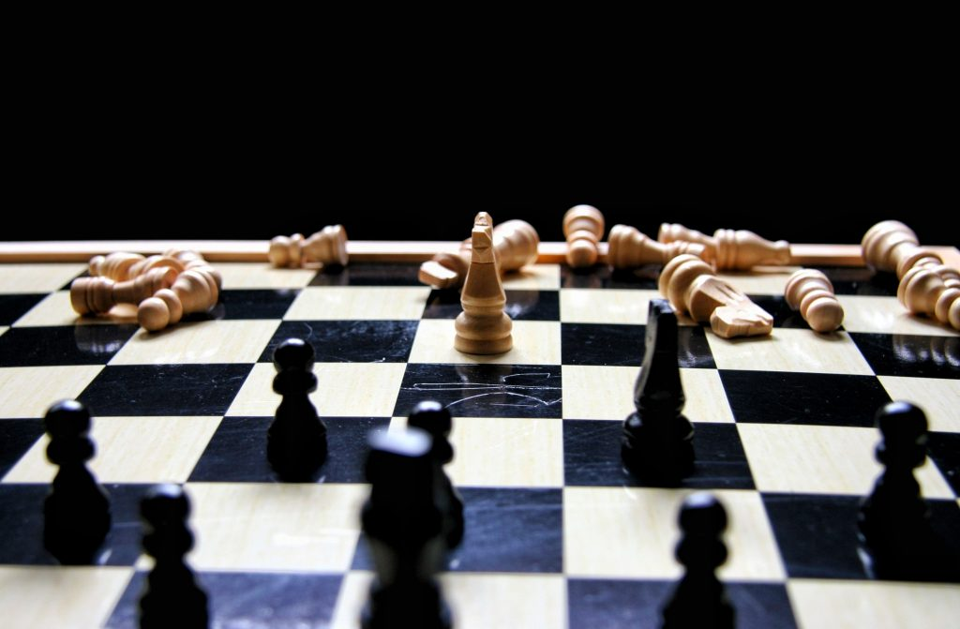
AI CHESS

Slide 2
Introduction
Chess is an abstract strategy game and involves no hidden information. It is played on a square chessboard with 64 squares arranged in an eight-by-eight grid. At the start, each player (one controlling the white pieces, the other controlling the black pieces) controls sixteen pieces: one king, one queen, two rooks, two knights, two bishops, and eight pawns. The object of the game is to checkmate the opponent's king, whereby the king is under immediate attack (in "check") and there is no way to remove it from attack on the next move. There are also several ways a game can end in a draw.
AI in chess is an analysis of the use of computers in playing chess, specifically middlegame strategies.

Slide 3
Background Theory and Problem Statement
At the beginning of every conception of a chess program lie the basics of chess: first and foremost the information on how each piece can move, how to set the king in checkmate and the basic value of all pieces must not be forgotten.
Basic concepts that will help us create a simple chess AI:
Step 1: Move generation and board visualization
Step 2 : Position evaluation
Step 3: Search tree using Minimax
Step 4: Alpha-beta pruning
Step 5: Improved evaluation function

Slide 4
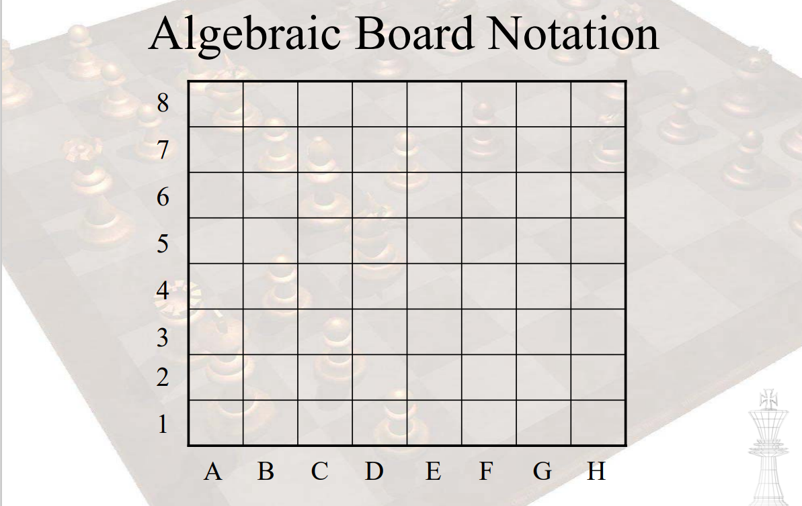

Slide 5
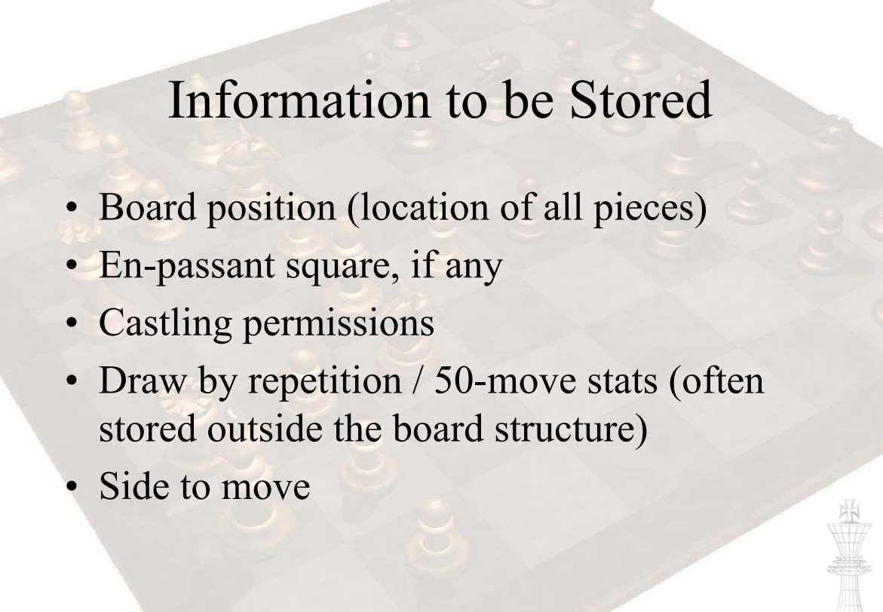

Slide 6
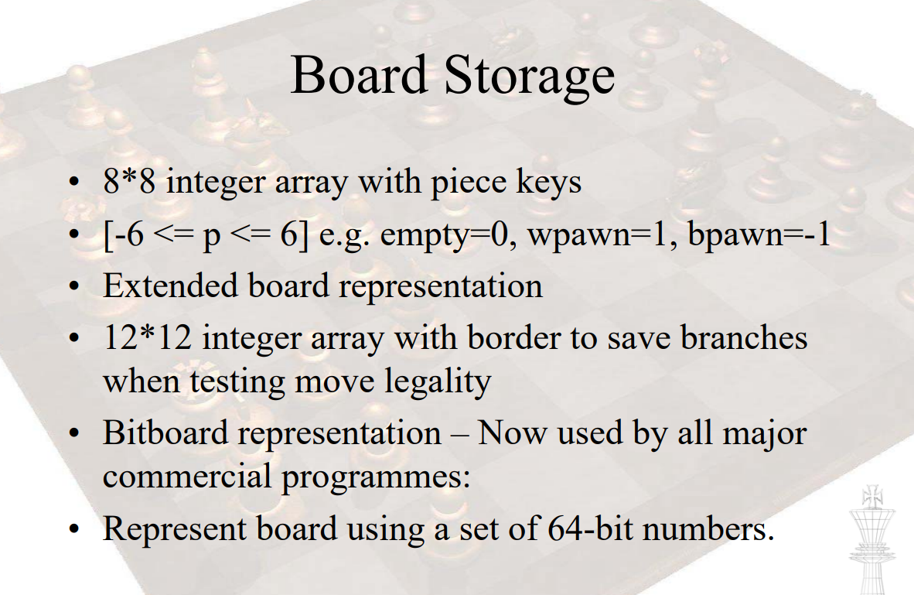

Slide 7
Proposed System and Scope of the System.
As artificial intelligence continues its rapid progress, equaling or surpassing human performance on benchmarks in an increasing range of tasks, researchers in the field are directing more effort to the interaction between humans and AI in domains where both are active.
Chess stands as a model system for studying how people can collaborate with AI, or learn from AI, just as chess has served as a leading indicator of many central questions in AI throughout the field’s history.

Slide 8
Proposed System and Scope of the System.
Chess has many cognitive benefits, including the ability to improve your:
intelligence
empathy
memory
planning and problem-solving skills
creative abilities
Chess can also help with the symptoms or severity of several health conditions, including dementia, ADHD, and panic attacks. In addition, playing this challenging game can help you find a sense of flow or improve the effectiveness of your therapy sessions.

Slide 9
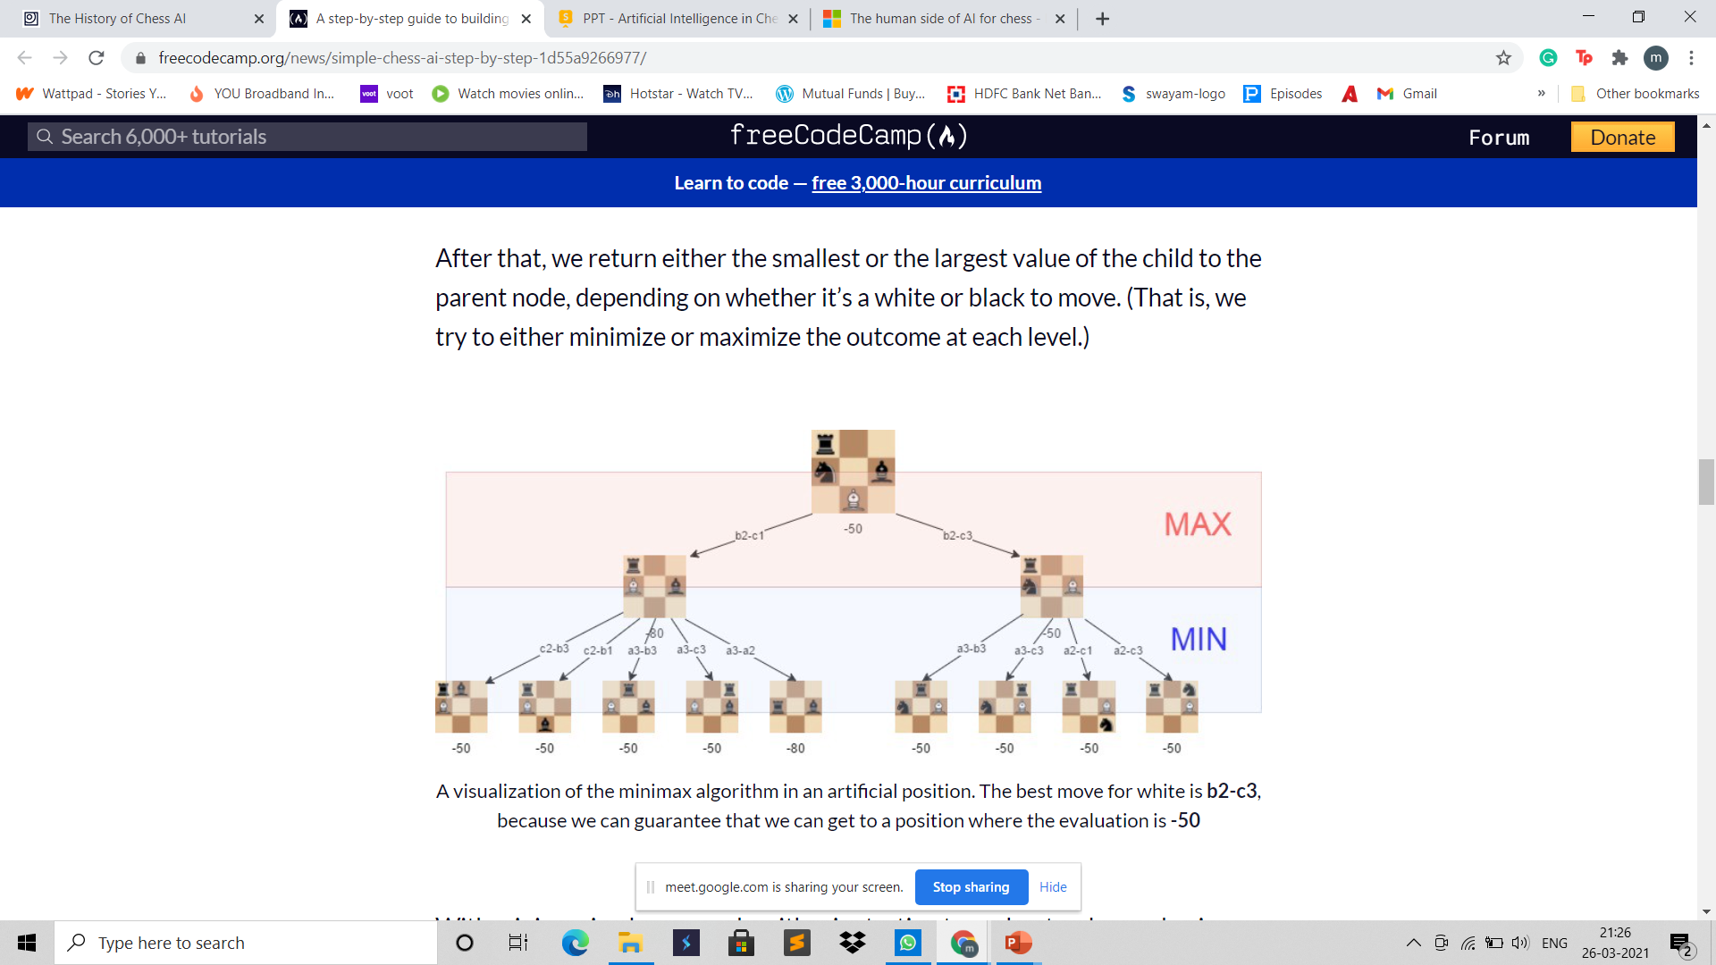
REQUIRMENT GATHERING TECHNIQUE USED
Minimax Algorithm
In this algorithm, the recursive tree of all possible moves is explored to a given depth, and the position is evaluated at the ending “leaves” of the tree.
After that, we return either the smallest or the largest value of the child to the parent node, depending on whether it’s a white or black to move. (That is, we try to either minimize or maximize the outcome at each level.)

Slide 10
REQUIRMENT GATHERING TECHNIQUE USED
Alpha-beta pruning
Alpha-beta pruning is an optimization method to the minimax algorithm that allows us to disregard some branches in the search tree. This helps us evaluate the minimax search tree much deeper, while using the same resources.
The alpha-beta pruning is based on the situation where we can stop evaluating a part of the search tree if we find a move that leads to a worse situation than a previously discovered move.
The alpha-beta pruning does not influence the outcome of the minimax algorithm — it only makes it faster.

Slide 11
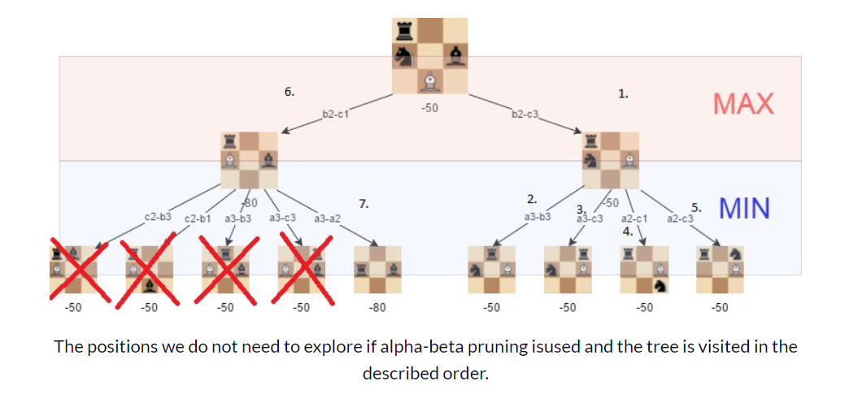
REQUIRMENT GATHERING TECHNIQUE USED
The alpha-beta algorithm also is more efficient if we happen to visit first those paths that lead to good moves.

Slide 12


Hardware and Software Requirements
HARDWARE
Pc or laptop
minimum requirement:-
i3 processor.
Ram of 4gb
Proper steady internet connection
SOFTWARE
Vs code

Slide 13
Project Definition and Planning
Our project is Artificial intelligence based chess using JavaScript.
We have used minimax algorithm and alpha beta pruning to give the logic behind the moves in this game.
We have developed the user interface using JavaScript.
This game also includes the level for all people of different ages.

Slide 14
CONCLUSION
The strength of even a simple chess-playing algorithm is that it doesn’t make stupid mistakes. This said, it still lacks strategic understanding.
In future chat with game can be implemented as well as the moves can be tracked and stored. Thus game can be improved with some small changes.

Slide 15
ROLES AND REPONSIBILITY OF TEAM MEMBERS
19DCS092 MANTHAN
Presentation(8,9,10,11)
Project(minimax function)
19DCS094 MOSAMI
Presentation(3,4,5,6,7)
Project( board and pieces design)
19DCS097 NUPUR
Presentation(2,12,13,14)
Project(board and pieces design)

Slide 16
References
https://www.freecodecamp.org/news/simple-chess-ai-step-by-step-1d55a9266977/
https://code.visualstudio.com/download
https://developer.mozilla.org/en-US/docs/Web/JavaScript
https://www.britannica.com/topic/chess

Slide 17
THANK YOU!

